Slide 1

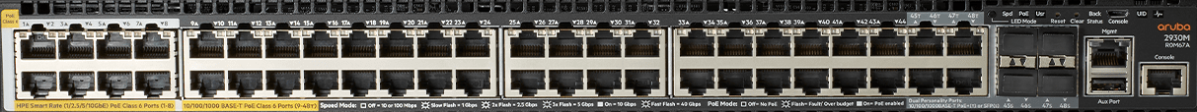





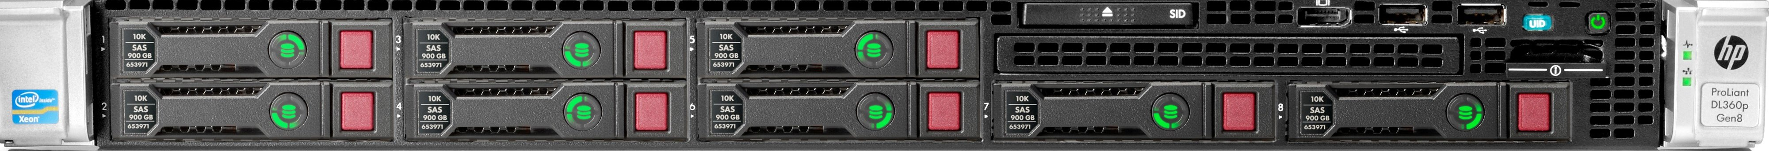



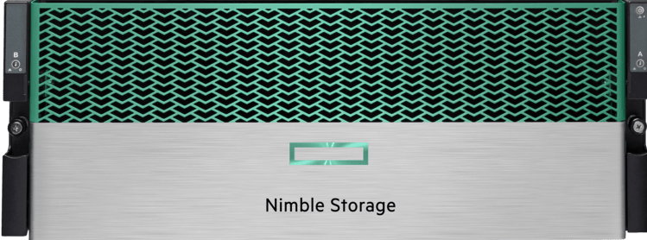


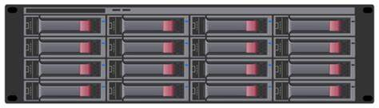

Tech profile – one site w/cloud v2
Updated: 01-2025 Name [SA]
Site Name
ToR:
(qty) Switch Model
Speed
Num Ports
Management:
(qty) Switch Model
Virtualization
Workloads
CLOUD
NETWORK
Workload 1
Workload 2
Workload 3
Workload 4
Workload 5
Workload 6
Cloud Information
(qty) Server 1
(qty) CPU Model
Memory Size
(qty) Server 2
(qty) CPU Model
Memory Size
(qty) Server 3
(qty) CPU Model
Memory Size
COMPUTE
Virtualization
INITIATIVES
Insert
Insert
Insert
Storage Appliance Model
Capacity
DR
DR Application
Description
STORAGE
Backup Name
Yearly Subscription
CHALLENGES
BACKUP
Insert
Insert
Insert
Power Information
*Visuals are based on Information Provided. This page can be updated and changed if information is incorrect.
Only for educational / display purposes.

Slide 2
Tech profile – one site w/cloud v2
Updated: 01-2025 Name [SA]
Site Name
Second Site Name
ToR:
(qty) Switch Model
Speed
Num Ports
Management:
(qty) Switch Model
ToR:
(qty) Switch Model
Speed
Num Ports
Management:
(qty) Switch Model
Virtualization
CLOUD
NETWORK
Cloud Information
(qty) Server 1
(qty) CPU Model
Memory Size
(qty) Server 2
(qty) CPU Model
Memory Size
(qty) Server 1
(qty) CPU Model
Memory Size
(qty) Server 2
(qty) CPU Model
Memory Size
Virtualization
COMPUTE
Workloads
Workload 1
Workload 2
Workload 3
INITIATIVES
Insert
Insert
Insert
Storage Appliance Model
Capacity
Storage Appliance Model
Capacity
STORAGE
Backup Name
Yearly Subscription
Backup Name
Yearly Subscription
DR
CHALLENGES
BACKUP
DR Application
Description
Insert
Insert
Insert
Power Information
Power Information
*Visuals are based on Information Provided. This page can be updated and changed if information is incorrect.
Only for educational / display purposes.

